Slide 1

STM32 Dist.
Micro103

Slide 2

Basic communication peripherals
2
UART (2.1)
UART Interrupt lab (2.1.2)
UART DMA lab (2.1.3)
SPI (2.2)
SPI Poll lab (2.2.1)
SPI Interrupt lab (2.2.2)

Slide 3
Timing peripherals
3
TIM (3.2)
TIM Interrupt lab (3.2.1)
TIM PWM out lab (3.2.2)

Slide 4
2.1.1 UART Poll lab

Slide 5
Simple UART communication
2.1.1
Objective
Learn how to setup UART in CubeMX
How to Generate Code in CubeMX and use HAL functions
Work in pairs, one will create transmitter and second receiver
Goal
Configure UART in CubeMX and Generate Code
Learn how to send and receive data over UART without interrupts
Verify the correct functionality

Slide 6
Simple UART communication
2.1.1
Create project in CubeMX
Menu > File > New Project
Select STM32F4 > STM32F429/439 > LQFP144 > STM32F439ZITx
Pin selection
We are looking for free pins where is possible to create wire loopback connection

Slide 7
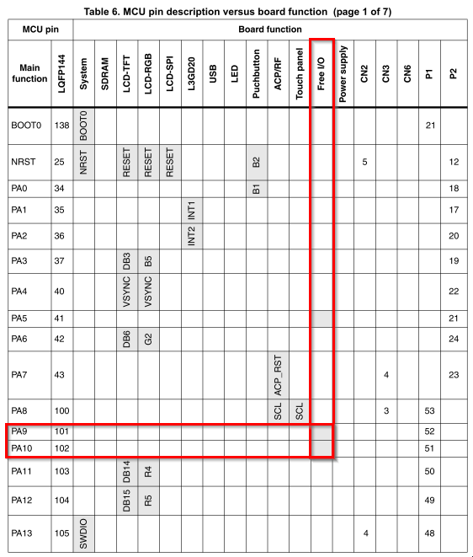
Simple UART communication
2.1.1
Pin selection
We are looking for free pins where is possible to create wire loopback connection
Image from STM32F429-Discovery user manual

Slide 8
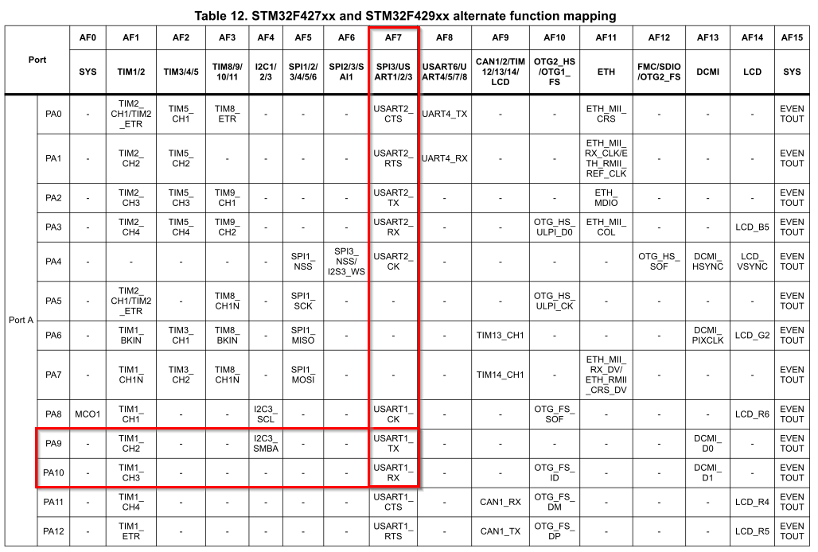
Simple UART communication
2.1.1
Pin selection
We are looking for free pins where is possible to create wire loopback connection
Image from STM32F429 datasheet

Slide 9
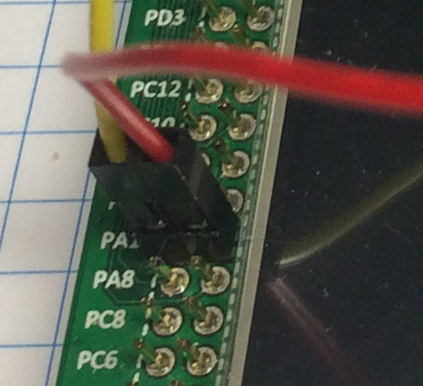
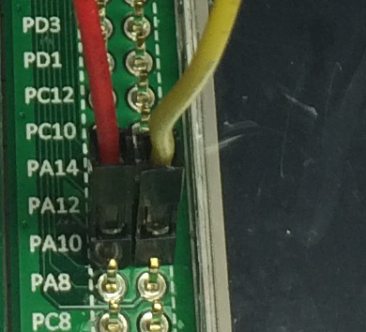
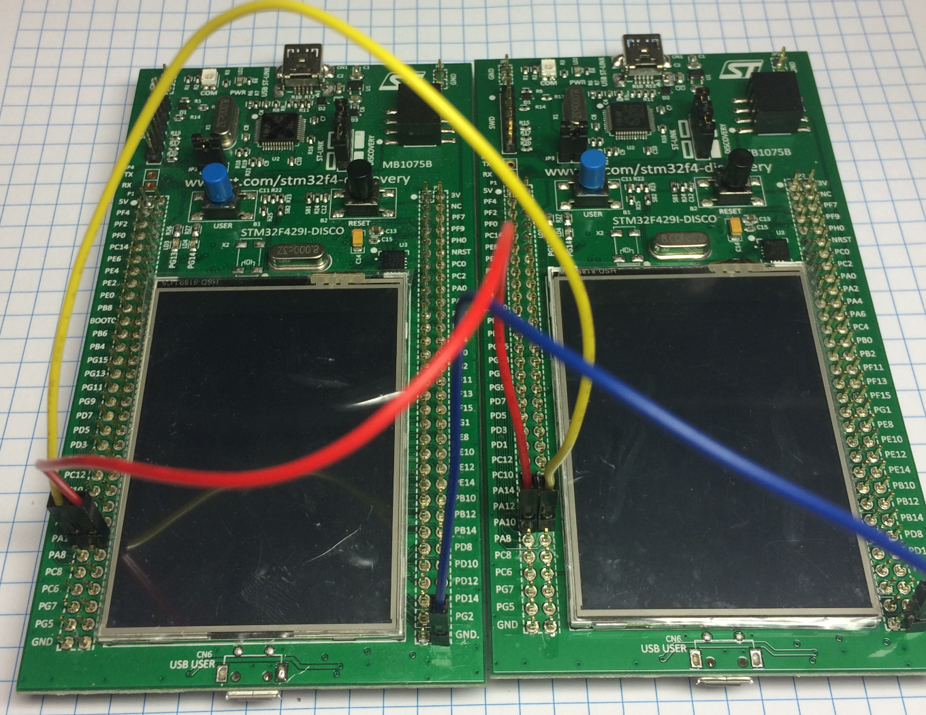
Simple UART communication
2.1.1
Hardware preparation
We connect selected pins together by jumper, this help us to create loopback on UART
Hardware connection RX <-TX
TX>RX

Slide 10
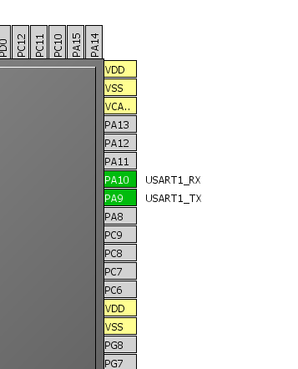
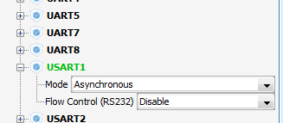
Simple UART communication
2.1.1
Create project in CubeMX
Menu > File > New Project
Select STM32F4 > STM32F429/439 > LQFP144 > STM32F439ZITx
CubeMX UART selection
Select USART1 in asynchronous mode
Select PA9 and PA10 for USART1 if weren't selected

Slide 11
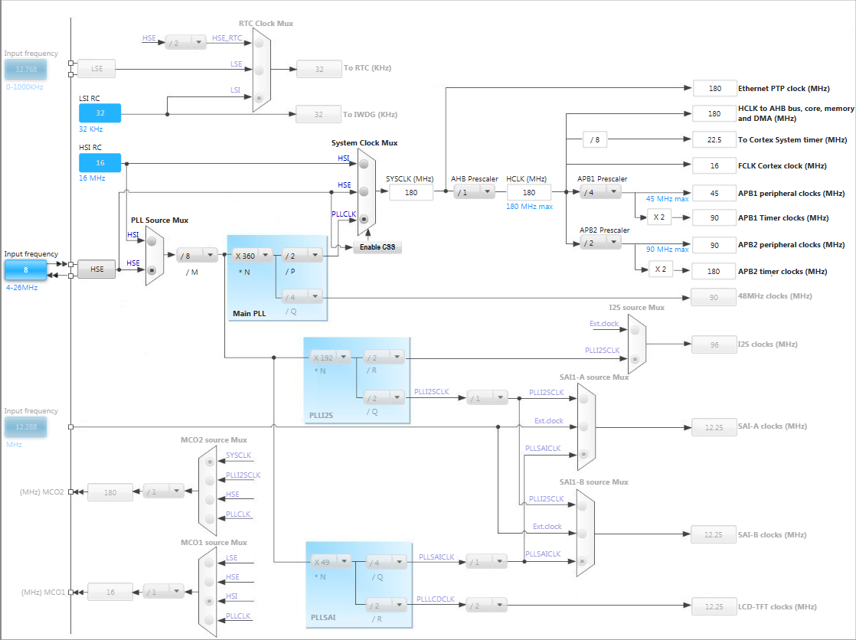
Simple UART communication
2.1.1
In order to run on maximum frequency, setup clock system
Details in lab 0

Slide 12
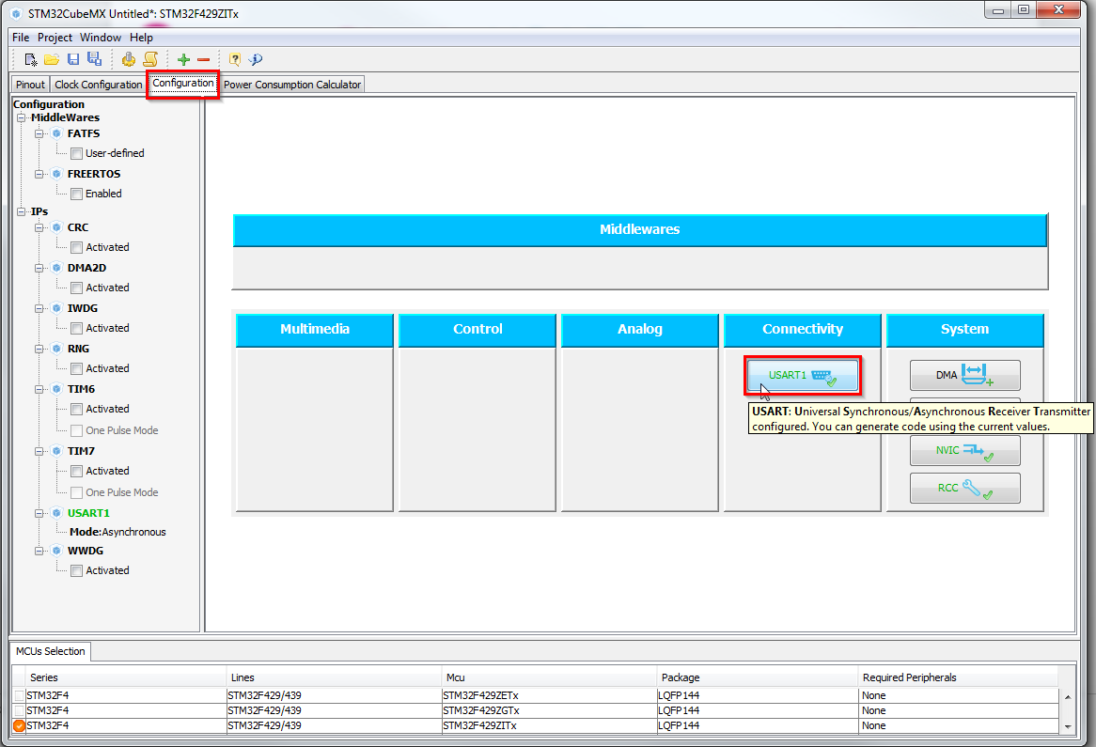
Simple UART communication
2.1.1
CubeMX UART configuration
Tab>Configuration>Connectivity>USART1

Slide 13
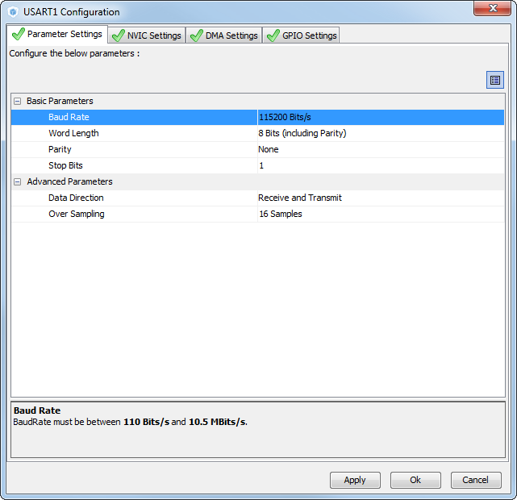
Simple UART communication
2.1.1
CubeMX USART configuration check:
BaudRate
World length
Parity
Stop bits
Data direction
Oversampling

Slide 14
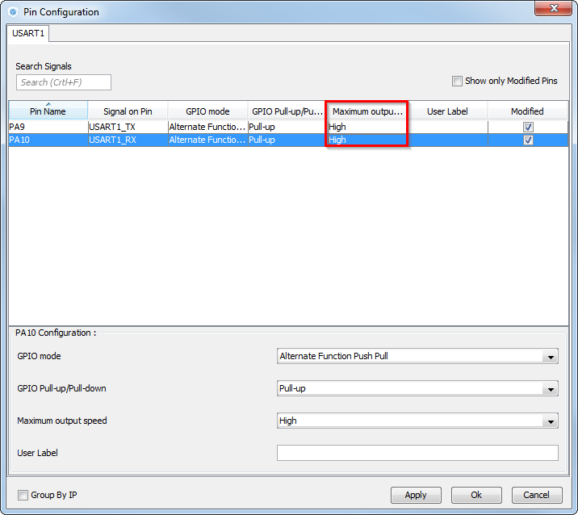
Simple UART communication
2.1.1
CubeMX USART GPIO configuration check:
On high baud rate set the GPIO speed to HIGH
TAB>Configuration>System> >GPIO
Set the HIGH output speed Button OK

Slide 15
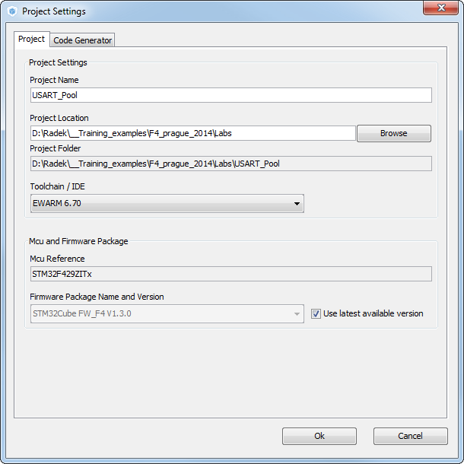
Simple UART communication
2.1.1
Now we set the project details for generation
Menu > Project > Project Settings
Set the project name
Project location
Type of toolchain
Now we can Generate Code
Menu > Project > Generate Code

Slide 16
Simple UART communication
2.1.1
HAL Library init flow
1. We need init UART1
Peripheral Initializations
MX_USART1_UART_Init();
2. Call UART1 init function
Init UART1 structure
3. Store UART1 configuration into structure
HAL_UART_Init(&huart1);
4. Write to UART1 registers
HAL_UART_MspInit callback
5. UART1 init callback
Init GPIO and NVIC for UART
6. UART1 GPIOS, NVIC and RCC init
7. Next periph init or user code

Slide 17
Simple UART communication
2.1.1
HAL Library transmit flow
Generated by CubeMX
Peripheral Initializations
Polling process
HAL_UART_Transmit/Receive
Function blocks
Polling with timeout
Created by user
HAL_TIMEOUT
HAL_OK
HAL_ERROR
HAL_BUSY

Slide 18
Simple UART communication
2.1.1
Open the project in our IDE
The functions we want to put into main.c
Between /* USER CODE BEGIN 3 */ and /* USER CODE END 3 */ tags
Into infinite while function
For transmit use function
HAL_UART_Transmit(UART_HandleTypeDef *huart, uint8_t *pData, uint16_t Size, uint32_t Timeout)
For receive use function
HAL_UART_Receive(UART_HandleTypeDef *huart, uint8_t *pData, uint16_t Size, uint32_t Timeout);

Slide 19
Simple UART communication
2.1.1
Transmit solution
Create data structure for data
Call transmit function from while loop
/* USER CODE BEGIN 0 */
uint8_t data[]={0,1,2,3,4,5,6,7,8,9};
/* USER CODE END 0 */
/* USER CODE BEGIN 3 */
/* Infinite loop */
while (1)
{
HAL_UART_Transmit(&huart1,data,10,1000);
}
/* USER CODE END 3 */

Slide 20
Simple UART communication
2.1.1
Receive solution
Create data structure for data
Call transmit function from while loop
/* USER CODE BEGIN 0 */
uint8_t data[10];
/* USER CODE END 0 */
/* USER CODE BEGIN 3 */
/* Infinite loop */
while (1)
{
HAL_UART_Receive(&huart1,data,10,1000);
}
/* USER CODE END 3 */

Slide 21
2.1.2 UART Interrupt lab

Slide 22
Use UART with interrupt
2.1.2
Objective
Learn how to setup UART with interrupts in CubeMX
How to Generate Code in CubeMX and use HAL functions
Create simple loopback example with interrupts
Goal
Configure UART in CubeMX and Generate Code
Learn how to send and receive data over UART with interrupts
Verify the correct functionality

Slide 23
Use UART with interrupt
2.1.2
Create project in CubeMX
Menu > File > New Project
Select STM32F4 > STM32F429/439 > LQFP144 > STM32F439ZITx
Pin selection
It will be same as previous lab we use again PA9 and PA10

Slide 24
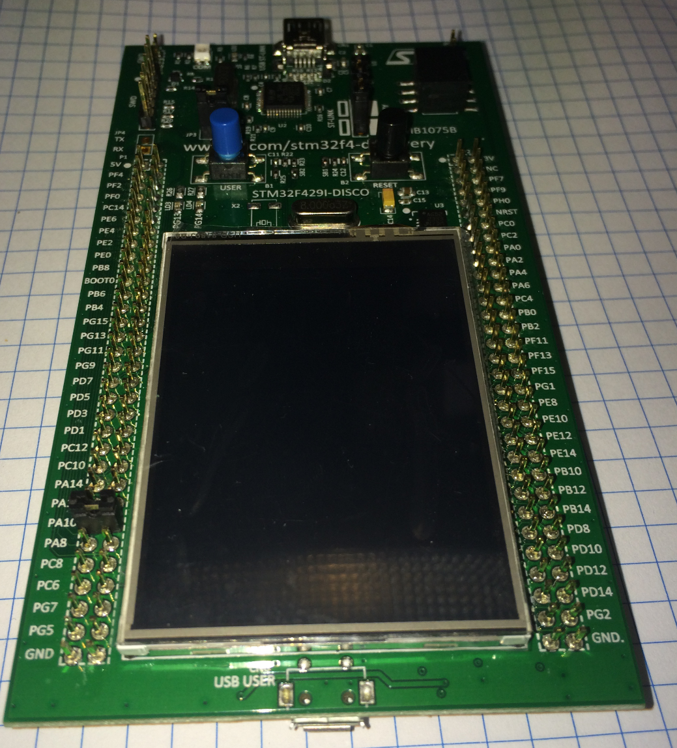
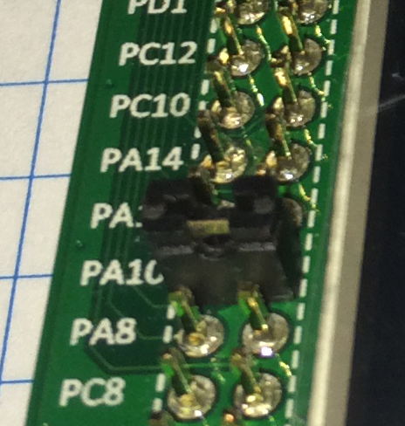
Use UART with interrupt
2.1.2
Hardware preparation
We connect selected pins together by jumper, this help us to create loopback on UART
Hardware loopback

Slide 25
Use UART with interrupt
2.1.2
In order to run on maximum frequency, setup clock system
Details in lab 0

Slide 26
Use UART with interrupt
2.1.2
CubeMX UART configuration
Tab>Configuration>Connectivity>USART1

Slide 27
Use UART with interrupt
2.1.2
CubeMX UART configuration check:
BaudRate
World length
Parity
Stop bits
Data direction
Oversampling

Slide 28
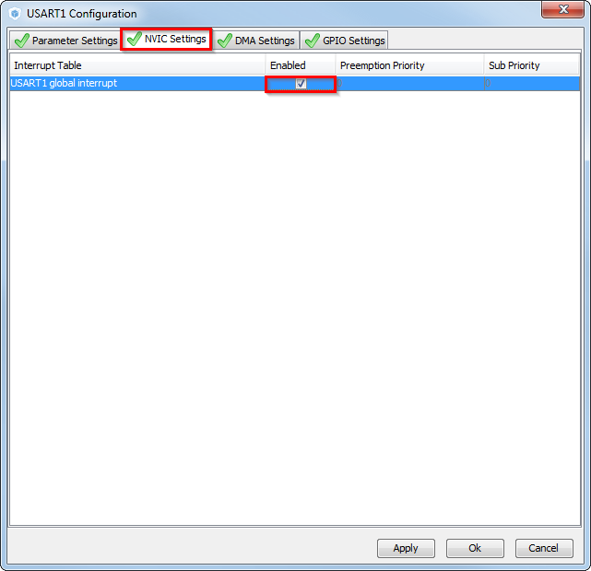
Use UART with interrupt
2.1.2
CubeMX USART configuration NVIC settings
TAB>NVIC Settings
Enable interrupts
OK

Slide 29
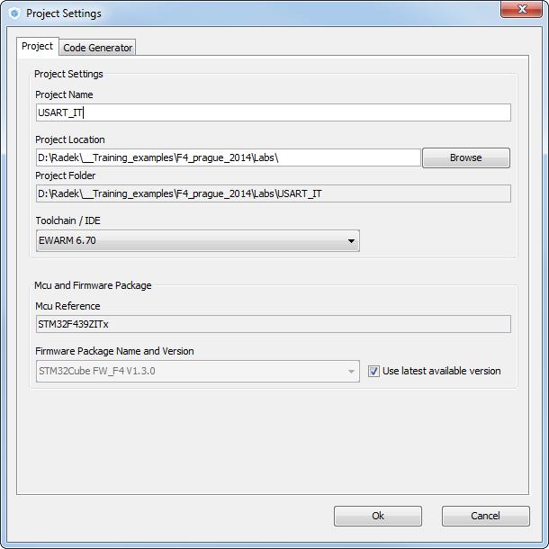
Use UART with interrupt
2.1.2
Now we set the project details for generation
Menu > Project > Project Settings
Set the project name
Project location
Type of toolchain
Now we can Generate Code
Menu > Project > Generate Code

Slide 30
Use UART with interrupt
2.1.2
HAL Library UART with IT transmit and receiev flow
Peripheral Initializations
including peripheral interrupt NVIC initializations
Start process with interrupt generation at end of process
HAL_UART_Transmit_IT / HAL_UART_Receive_IT
HAL_OK
HAL_ERROR
HAL_UART_IRQHandler
USART1_IRQHandler
HAL_BUSY
end of process callback
HAL_UART_TxCpltCallback
HAL_UART_RxCpltCallback
process Error callback
HAL_UART_ErrorCallback

Slide 31
Use UART with interrupt
2.1.2
Open the project in our IDE
The functions we want to put into main.c
Between /* USER CODE BEGIN 2 */ and /* USER CODE END 2 */ tags
For transmit use function
HAL_UART_Transmit_IT(UART_HandleTypeDef *huart, uint8_t *pData, uint16_t Size);
For receive use function
HAL_UART_Receive_IT(UART_HandleTypeDef *huart, uint8_t *pData, uint16_t Size);

Slide 32
Use UART with interrupt
2.1.2
Buffer definition
Sending and receiving methods
/* USER CODE BEGIN 0 */
uint8_t tx_buff[]={0,1,2,3,4,5,6,7,8,9};
uint8_t rx_buff[10];
/* USER CODE END 0 */
/* USER CODE BEGIN 2 */
HAL_UART_Receive_IT(&huart1,rx_buff,10);
HAL_UART_Transmit_IT(&huart1,tx_buff,10);
/* USER CODE END 2 */

Slide 33
Use UART with interrupt
2.1.2
Complete callback check
We can put brakepoints on NOPs to watch if we send or receive complete buffer
/* USER CODE BEGIN 4 */
void HAL_UART_RxCpltCallback(UART_HandleTypeDef *huart)
{
__NOP();//test if we reach this position
}
void HAL_UART_TxCpltCallback(UART_HandleTypeDef *huart)
{
__NOP();//test if we reach this position
}
/* USER CODE END 4 */

Slide 34
2.1.3 UART DMA lab

Slide 35
Use UART with DMA transfer
2.1.3
Objective
Learn how to setup UART with DMA in CubeMX
How to Generate Code in CubeMX and use HAL functions
Create simple loopback example with DMA
Goal
Configure UART in CubeMX and Generate Code
Learn how to send and receive data over UART with DMA
Verify the correct functionality

Slide 36
Use UART with DMA transfer
2.1.3
Create project in CubeMX
Menu > File > New Project
Select STM32F4 > STM32F429/439 > LQFP144 > STM32F439ZITx
Pin selection
It will be same as previous lab we use again PA9 and PA10

Slide 37
Use UART with DMA transfer
2.1.3
Hardware preparation
We connect selected pins together by jumper, this help us to create loopback on UART
Hardware loopback

Slide 38
Use UART with DMA transfer
2.1.3
In order to run on maximum frequency, setup clock system
Details in lab 0

Slide 39
Use UART with DMA transfer
2.1.3
CubeMX UART configuration
Tab>Configuration>Connectivity>USART1

Slide 40
Use UART with DMA transfer
2.1.3
CubeMX USART configuration check:
BaudRate
World length
Parity
Stop bits
Data direction
Oversampling

Slide 41
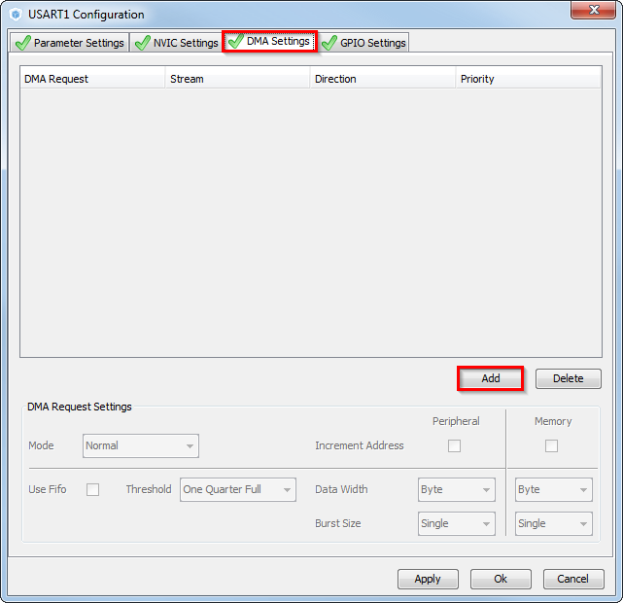
Use UART with DMA transfer
2.1.3
CubeMX USART configuration DMA settings
TAB>DMA Settings
Button ADD

Slide 42
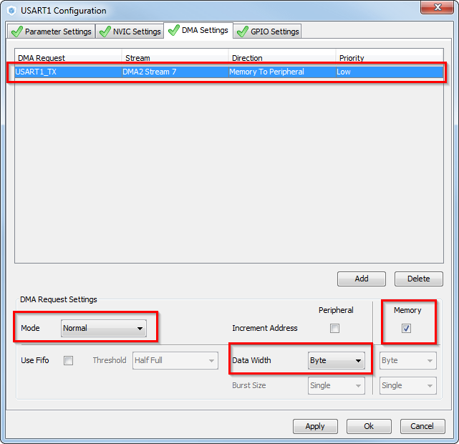
Use UART with DMA transfer
2.1.3
CubeMX USART configuration DMA Tx settings
Set USART1_TX request
Memory to peripheral direction
Normal mode
Byte data width
Increment memory address

Slide 43
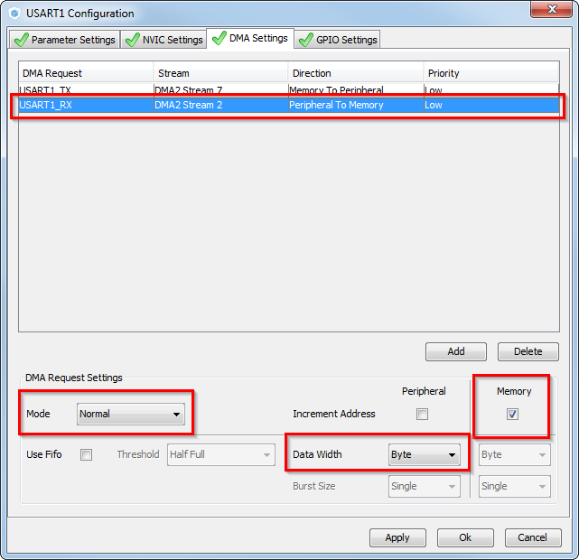
Use UART with DMA transfer
2.1.3
CubeMX USART configuration DMA Rx settings
Button ADD
Set USART1_RX request
Peripheral to memory direction
Normal mode
Byte data width
Increment memory address

Slide 44
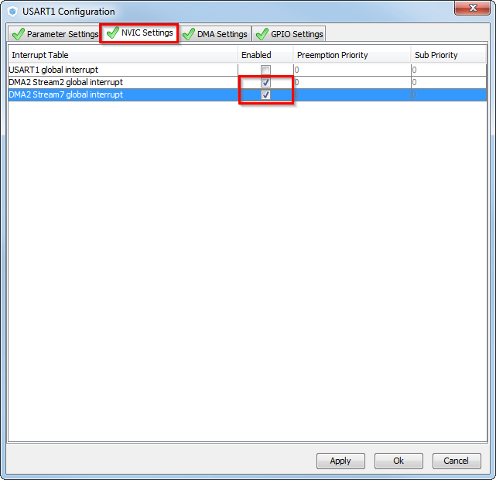
Use UART with DMA transfer
2.1.3
CubeMX USART configuration NVIC settings
TAB>NVIC Settings
Enable DMA2 interrupts for USART1
Button OK

Slide 45

Use UART with DMA transfer
2.1.3
Now we set the project details for generation
Menu > Project > Project Settings
Set the project name
Project location
Type of toolchain
Now we can Generate Code
Menu > Project > Generate Code

Slide 46
Use UART with DMA transfer
2.1.3
HAL Library UART with DMA RX flow
Peripheral Initializations
including DMA stream initializations
Start process with DMA end of transfer interrupt generation at end of process
HAL_UART_Receive_DMA
HAL_OK
HAL_ERROR
HAL_ERROR
HAL_DMA_IRQHandler
DMA_Stream_IRQHandler
end of process callback
HAL_UART_RxCpltCallback
process Error callback
HAL_UART_ErrorCallback

Slide 47
Use UART with DMA transfer
2.1.3
Open the project in our IDE
The functions we want to put into main.c
Between /* USER CODE BEGIN 2 */ and /* USER CODE END 2 */ tags
For transmit use function
HAL_UART_Transmit_DMA(UART_HandleTypeDef *huart, uint8_t *pData, uint16_t Size);
For receive use function
HAL_UART_Receive_DMA(UART_HandleTypeDef *huart, uint8_t *pData, uint16_t Size);

Slide 48
Use UART with DMA transfer
2.1.3
Buffer definition
Sending and receiving methods with DMA
/* USER CODE BEGIN 0 */
uint8_t tx_buff[]={0,1,2,3,4,5,6,7,8,9};
uint8_t rx_buff[10];
/* USER CODE END 0 */
/* USER CODE BEGIN 2 */
HAL_UART_Receive_DMA(&huart1,rx_buff,10);
HAL_UART_Transmit_DMA(&huart1,tx_buff,10);
/* USER CODE END 2 */

Slide 49
Use UART with DMA transfer
2.1.3
Complete callback check
We can put breakpoints on NOPs to watch if we receive complete buffer
/* USER CODE BEGIN 4 */
void HAL_UART_RxCpltCallback(UART_HandleTypeDef *huart)
{
__NOP();//check if we receive all data
}
/* USER CODE END 4 */

Slide 50
2.2.1 SPI Poll lab

Slide 51
Simple SPI communication
2.2.1
Objective
Learn how to setup SPI in CubeMX
How to Generate Code in CubeMX and use HAL functions
Goal
Configure SPI in CubeMX and Generate Code
Learn how to send and receive data over SPI without interrupts
Verify the correct functionality

Slide 52
Simple SPI communication
2.2.1
Create project in CubeMX
Menu > File > New Project
Select STM32F4 > STM32F429/439 > LQFP144 > STM32F439ZITx
Pin selection
We are looking for free pins where is possible to create wire loopback connection

Slide 53
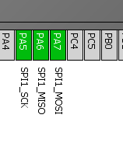
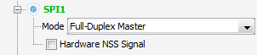
Simple SPI communication
2.2.1
Create project in CubeMX
Menu > File > New Project
Select STM32F4 > STM32F429/439 > LQFP144 > STM32F439ZITx
CubeMX SPI selection
Select SPI1 Full-Duplex Master
Select PA5, PA6, PA7 for SPI1 if weren't selected

Slide 54
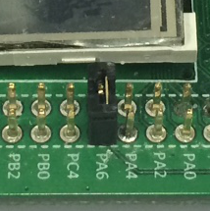
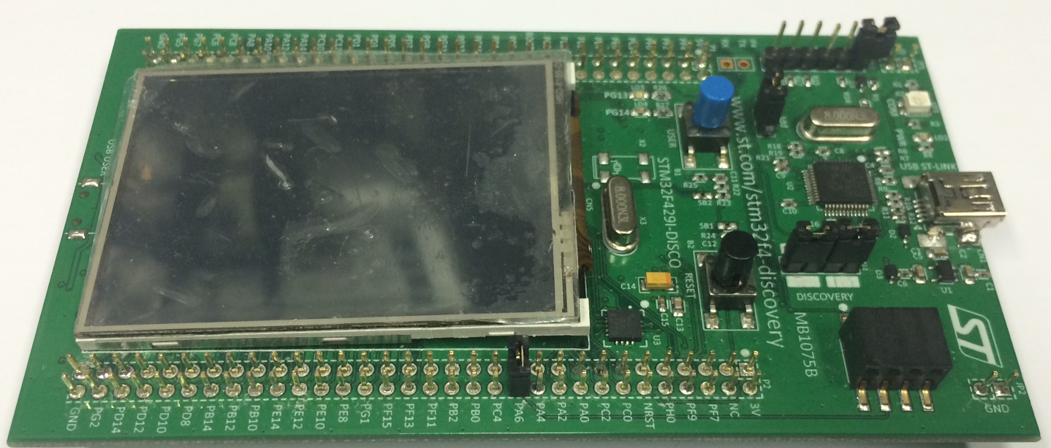
Simple SPI communication
2.2.1
Hardware preparation
Connect PA6 and PA7 together with jumper
Hardware loopback

Slide 55
Simple SPI communication
2.2.1
In order to run on maximum frequency, setup clock system
Details in lab 0

Slide 56
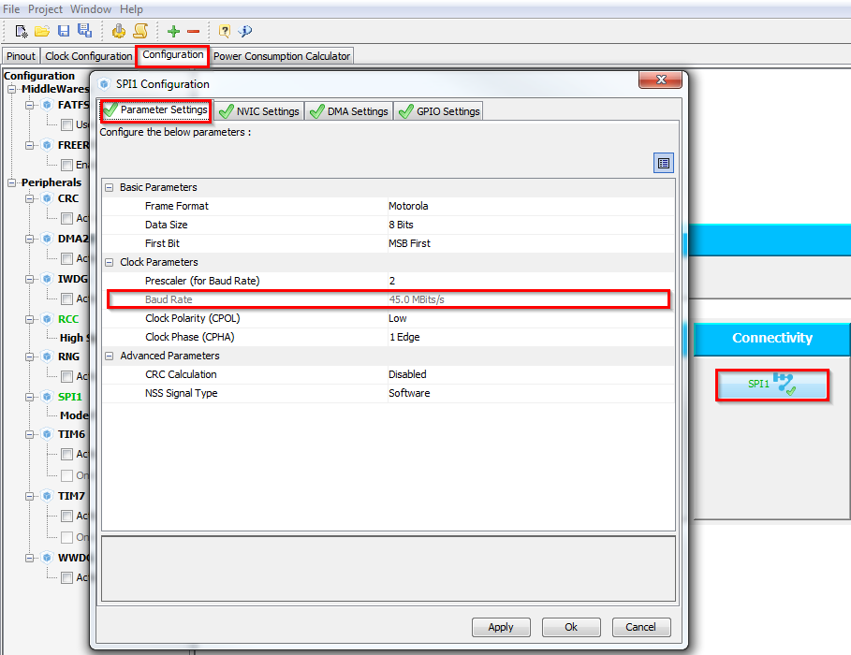
Simple SPI communication
2.2.1
CubeMX SPI configuration
Tab>Configuration>Connectivity>SPI1
Check the settings
Button OK
The CLK frequency with core on 180MHz is now 45MHz
For this clock use HIGH GPIO speed

Slide 57
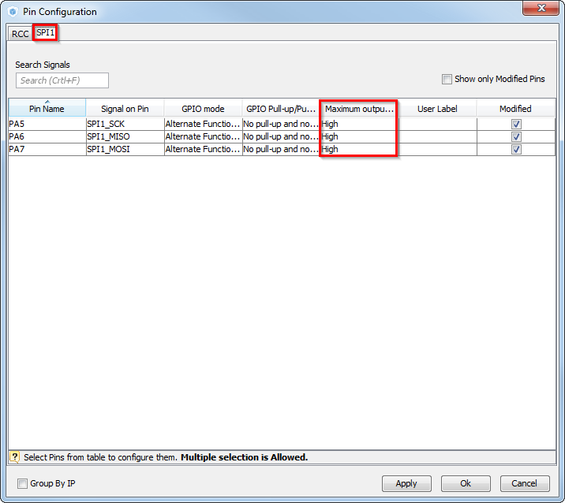
Simple SPI communication
2.2.1
CubeMX SPI – GPIO configuration
The SPI CLK frequency with core on 180MHz is now 45MHz
For this clock use HIGH GPIO speed
Tab>Configuration>System> >GPIO
Tab>SPI1
Seth High output speed
Button OK

Slide 58
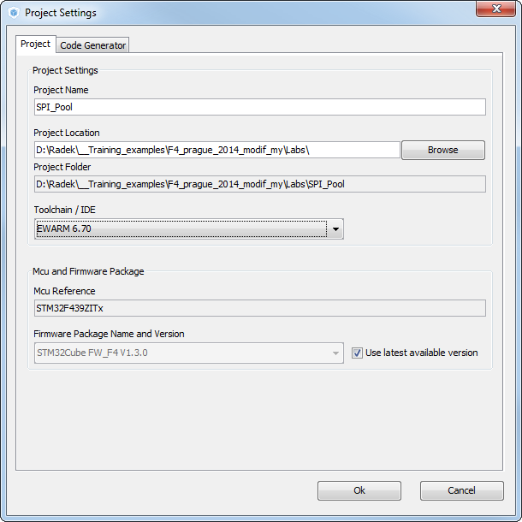
Simple SPI communication
2.2.1
Now we set the project details for generation
Menu > Project > Project Settings
Set the project name
Project location
Type of toolchain
Now we can Generate Code
Menu > Project > Generate Code

Slide 59
Simple SPI communication
2.2.1
HAL Library transmit receive flow
Peripheral Initializations
Polling process
HAL_SPI_TransmitReceive
Function blocks
Polling with timeout
HAL_TIMEOUT
HAL_OK
HAL_ERROR
HAL_BUSY

Slide 60
Simple SPI communication
2.2.1
Open the project in our IDE
The functions we want to put into main.c
Between /* USER CODE BEGIN 3 */ and /* USER CODE END 3 */ tags
For transmit and receive use function
HAL_SPI_TransmitReceive(SPI_HandleTypeDef *hspi, uint8_t *pTxData, uint8_t *pRxData, uint16_t Size, uint32_t Timeout)

Slide 61
Simple SPI communication
2.2.1
Transmit receive solution
Create data structure for data
Call transmit receive function
/* USER CODE BEGIN PV */
uint8_t tx_buffer[]={0,1,2,3,4,5,6,7,8,9};
uint8_t rx_buffer[10];
/* USER CODE END PV */
/* USER CODE BEGIN 2 */
HAL_SPI_TransmitReceive(&hspi1,tx_buffer,rx_buffer,10,100);
/* USER CODE END 2 */

Slide 62
2.2.2 SPI Interrupt lab

Slide 63
Use SPI with interrupt
2.2.2
Objective
Learn how to setup SPI with interrupts in CubeMX
How to Generate Code in CubeMX and use HAL functions
Create simple loopback example with interrupts
Goal
Configure SPI in CubeMX and Generate Code
Learn how to send and receive data over SPI with interrupts
Verify the correct functionality

Slide 64
Use SPI with interrupt
2.2.2
Create project in CubeMX
Menu > File > New Project
Select STM32F4 > STM32F429/439 > LQFP144 > STM32F439ZITx
CubeMX SPI selection
Select SPI1 Full-Duplex Master
Select PA5, PA6, PA7 for SPI1 if weren't selected

Slide 65
Use SPI with interrupt
2.2.2
Hardware preparation
Connect PA6 and PA7 together with jumper
Hardware loopback

Slide 66
Use SPI with interrupt
2.2.2
In order to run on maximum frequency, setup clock system
Details in lab 0

Slide 67
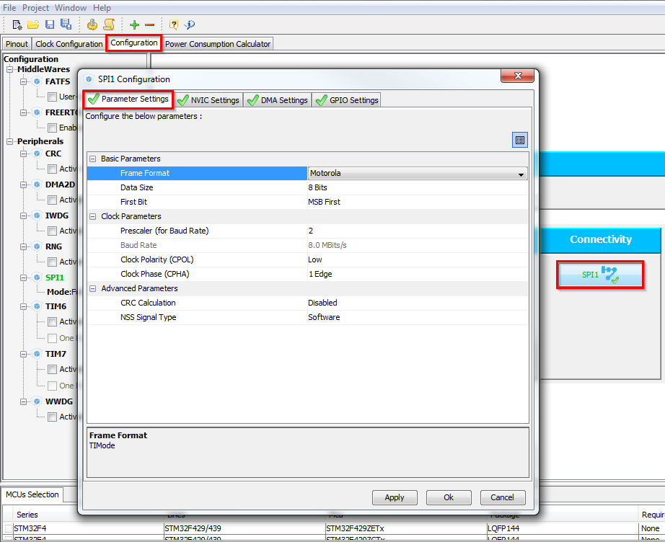
Use SPI with interrupt
2.2.2
CubeMX SPI configuration
Tab>Configuration>Connectivity>SPI1
Check the settings
Button OK

Slide 68
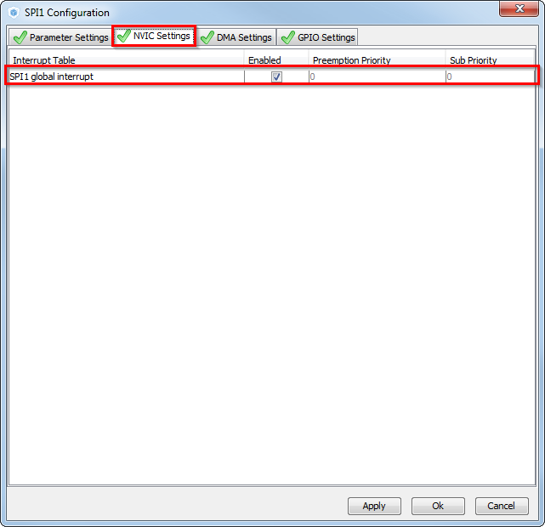
Use SPI with interrupt
2.2.2
CubeMX SPI configuration
TAB>NVIC Settings
Enable SPI interrupt
Button OK

Slide 69
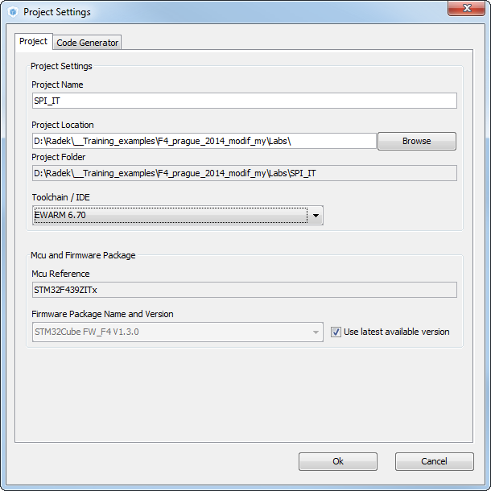
Use SPI with interrupt
2.2.2
Now we set the project details for generation
Menu > Project > Project Settings
Set the project name
Project location
Type of toolchain
Now we can Generate Code
Menu > Project > Generate Code

Slide 70
Use SPI with interrupt
2.2.2
HAL Library SPI with IT transmit receive flow
Peripheral Initializations
including peripheral interrupt NVIC initializations
Start process with interrupt generation at end of process
HAL_SPI_TransmitReceive_IT
HAL_OK
HAL_ERROR
HAL_SPI_IRQHandler
SPI1_IRQHandler
HAL_BUSY
end of process callback
HAL_SPI_TxRxCpltCallback
process Error callback
HAL_SPI_ErrorCallback

Slide 71
Use SPI with interrupt
2.2.2
Open the project in our IDE
The functions we want to put into main.c
Between /* USER CODE BEGIN 2 */ and /* USER CODE END 2 */ tags
For transmit use function
HAL_SPI_TransmitReceive_IT(SPI_HandleTypeDef *hspi, uint8_t *pTxData, uint8_t *pRxData, uint16_t Size)

Slide 72
Use SPI with interrupt
2.2.2
Buffer definition
Sending and receiving methods
/* USER CODE BEGIN 0 */
uint8_t tx_buff[]={0,1,2,3,4,5,6,7,8,9};
uint8_t rx_buff[10];
/* USER CODE END 0 */
/* USER CODE BEGIN 2 */
HAL_SPI_TransmitReceive_IT(&hspi1,tx_buff,rx_buff,10);
/* USER CODE END 2 */

Slide 73
Use SPI with interrupt
2.2.2
Complete callback check
We can put breakpoints on NOPs to watch if we send or receive complete buffer
/* USER CODE BEGIN 4 */
void HAL_SPI_TxRxCpltCallback(SPI_HandleTypeDef *hspi)
{
__NOP();
}
/* USER CODE END 4 */

Slide 74
3.2.1 TIM with interrupt lab

Slide 75
Use TIM with interrupt
3.2.1
Objective
Learn how to setup TIM with Interrupt in CubeMX
How to Generate Code in CubeMX and use HAL functions
Indicate TIM interrupt with LED toggle
Goal
Configure TIM in CubeMX and Generate Code
Learn how start timer and handle interrupt
Verify the correct functionality

Slide 76
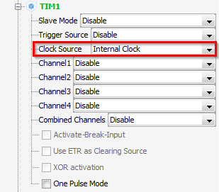
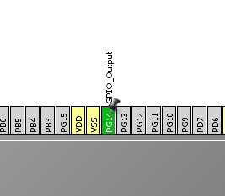
Use TIM with interrupt
3.2.1
Create project in CubeMX
Menu > File > New Project
Select STM32F4 > STM32F429/439 > LQFP144 > STM32F439ZITx
CubeMX TIM selection
Select TIM clock source Internal clock
Enable GPIO for LED PG14

Slide 77
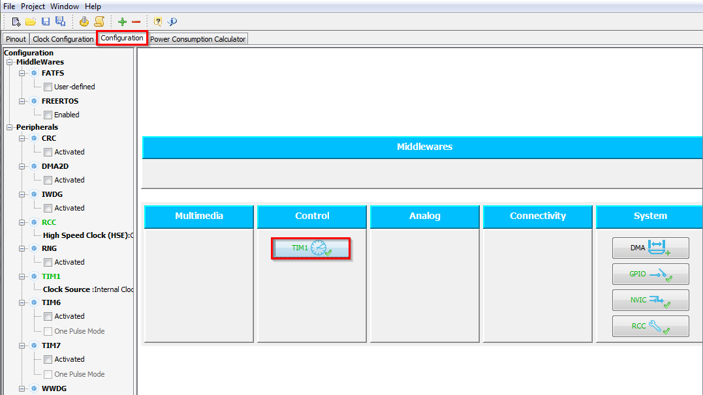
Use TIM with interrupt
3.2.1
CubeMX TIM configuration
Tab>Configuration>Control>TIM1
Check the settings

Slide 78
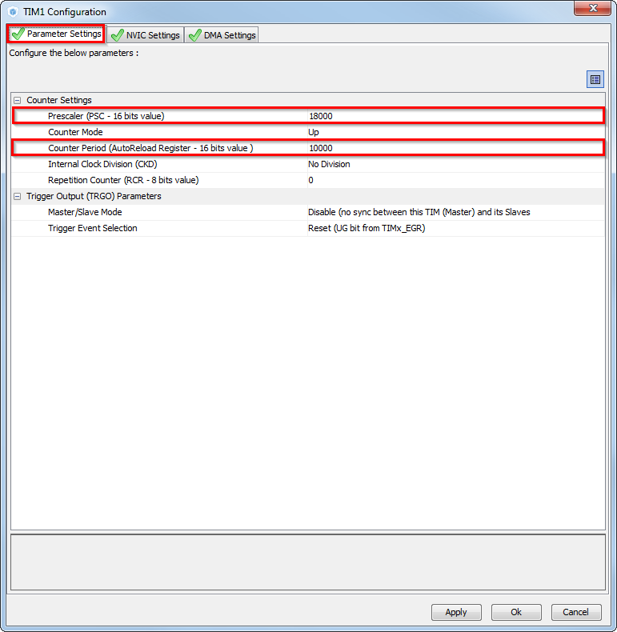
Use TIM with interrupt
3.2.1
CubeMX TIM configuration
Tab>Parameter Settings
Prescaler to 18000
Counter period to 10000
Together with 180MHz TIMER1 clock we get period 1Hz

Slide 79
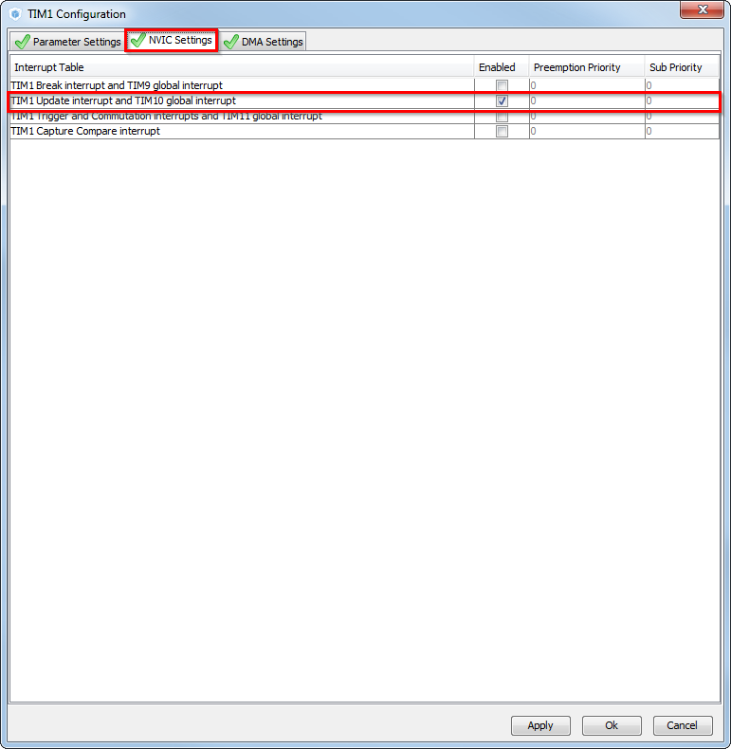
Use TIM with interrupt
3.2.1
CubeMX TIM configuration
Tab>NVIC Settings
Enable TIM1 Update interrupt
Button OK

Slide 80
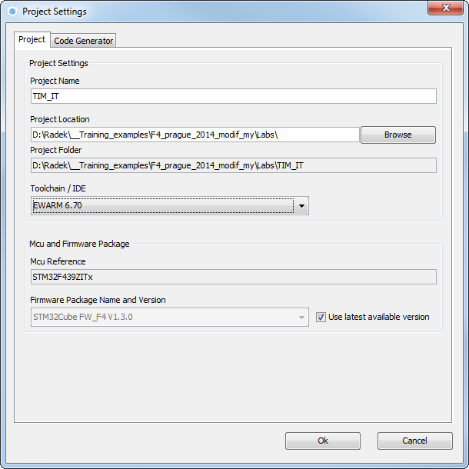
Use TIM with interrupt
3.2.1
Now we set the project details for generation
Menu > Project > Project Settings
Set the project name
Project location
Type of toolchain
Now we can Generate Code
Menu > Project > Generate Code

Slide 81
Use TIM with interrupt
3.2.1
HAL Library TIM with IT flow
TIM Initializations
including peripheral interrupt NVIC initializations
Start process with interrupt generation at end of process
HAL_TIM_Base_Start_IT
HAL_OK
HAL_ERROR
HAL_TIM_IRQHandler
TIM1_UP_TIM10_IRQHandler
HAL_BUSY
process callback
HAL_TIM_PeriodElapsedCallback
process Error callback
HAL_TIM_ErrorCallback

Slide 82
Use TIM with interrupt
3.2.1
Open the project in our IDE
The functions we want to put into main.c
Between /* USER CODE BEGIN 2 */ and /* USER CODE END 2 */ tags
For TIM start use function
HAL_TIM_Base_Start_IT(TIM_HandleTypeDef *htim)
TIM callback
void TIM1_UP_TIM10_IRQHandler(void)
GPIO LED toggle
HAL_GPIO_TogglePin(GPIO_TypeDef* GPIOx, uint16_t GPIO_Pin)

Slide 83
Use TIM with interrupt
3.2.1
Solution
TIM start
Callback handling
/* USER CODE BEGIN 2 */
HAL_TIM_Base_Start_IT(&htim1);
/* USER CODE END 2 */
/* USER CODE BEGIN 4 */
void HAL_TIM_PeriodElapsedCallback(TIM_HandleTypeDef *htim)
{
HAL_GPIO_TogglePin(GPIOG,GPIO_PIN_14);
}
/* USER CODE END 4 */

Slide 84
3.2.2 TIM with PWM output lab

Slide 85
Use TIM with PWM output
3.2.2
Objective
Learn how to setup TIM with PWM out in CubeMX
How to Generate Code in CubeMX and use HAL functions
Indicate TIM PWM on LED
Goal
Configure TIM in CubeMX and Generate Code
Learn how start timer and set PWM out
Verify the correct functionality with LED

Slide 86
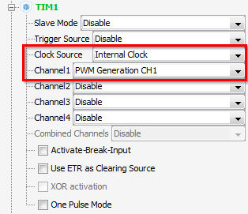
Use TIM with PWM output
3.2.2
Create project in CubeMX
Menu > File > New Project
Select STM32F4 > STM32F429/439 > LQFP144 > STM32F439ZITx
CubeMX TIM selection
Select TIM clock source - Internal clock
Set Channel1 to PWM generation

Slide 87
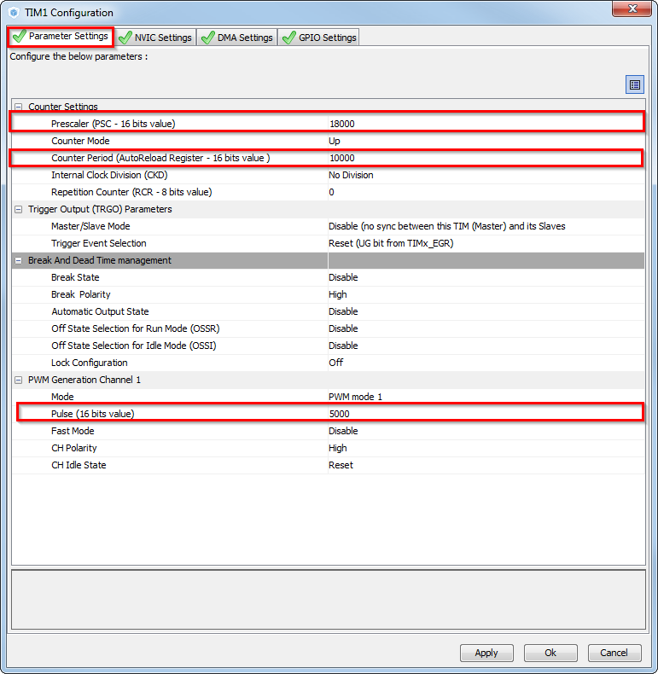
Use TIM with PWM output
3.2.2
CubeMX TIM configuration
TAB>Configuration >Control>TIM1
TAB>Parameter settings
Prescaler to 18000
Counter period to 10000
Together with 180MHz TIMER1 clock we get period 1Hz
PWM pulse to 5000 this give us 1Hz blinking frequency

Slide 88

Use TIM with PWM output
3.2.2
Now we set the project details for generation
Menu > Project > Project Settings
Set the project name
Project location
Type of toolchain
Now we can Generate Code
Menu > Project > Generate Code

Slide 89
Use TIM with PWM output
3.2.2
Start process TIM with PWM(same for DMA, ADC)
Non blocking start process
Peripheral Initializations
Start Process
HAL_TIM_PWM_Start

Slide 90
Use TIM with PWM output
3.2.2
Open the project in our IDE
The functions we want to put into main.c
Between /* USER CODE BEGIN 2 */ and /* USER CODE END 2 */ tags
For TIM start use function
HAL_TIM_PWM_Start(TIM_HandleTypeDef *htim, uint32_t Channel)
GPIO LED toggle
We wire the Channel1 PE9 with LED PG14

Slide 91
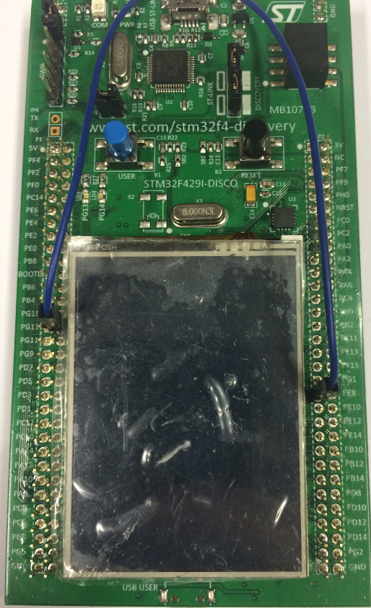
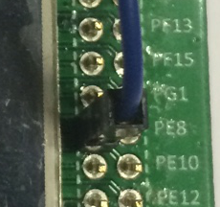
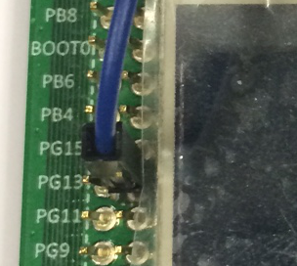
Use TIM with PWM output
3.2.2
Solution
TIM PWM start
TIM1 Channel 1 and LED connection
/* USER CODE BEGIN 2 */
HAL_TIM_PWM_Start(&htim1,TIM_CHANNEL_1);
/* USER CODE END 2 */

Slide 92
www.st.com/stm32

